Slide 1
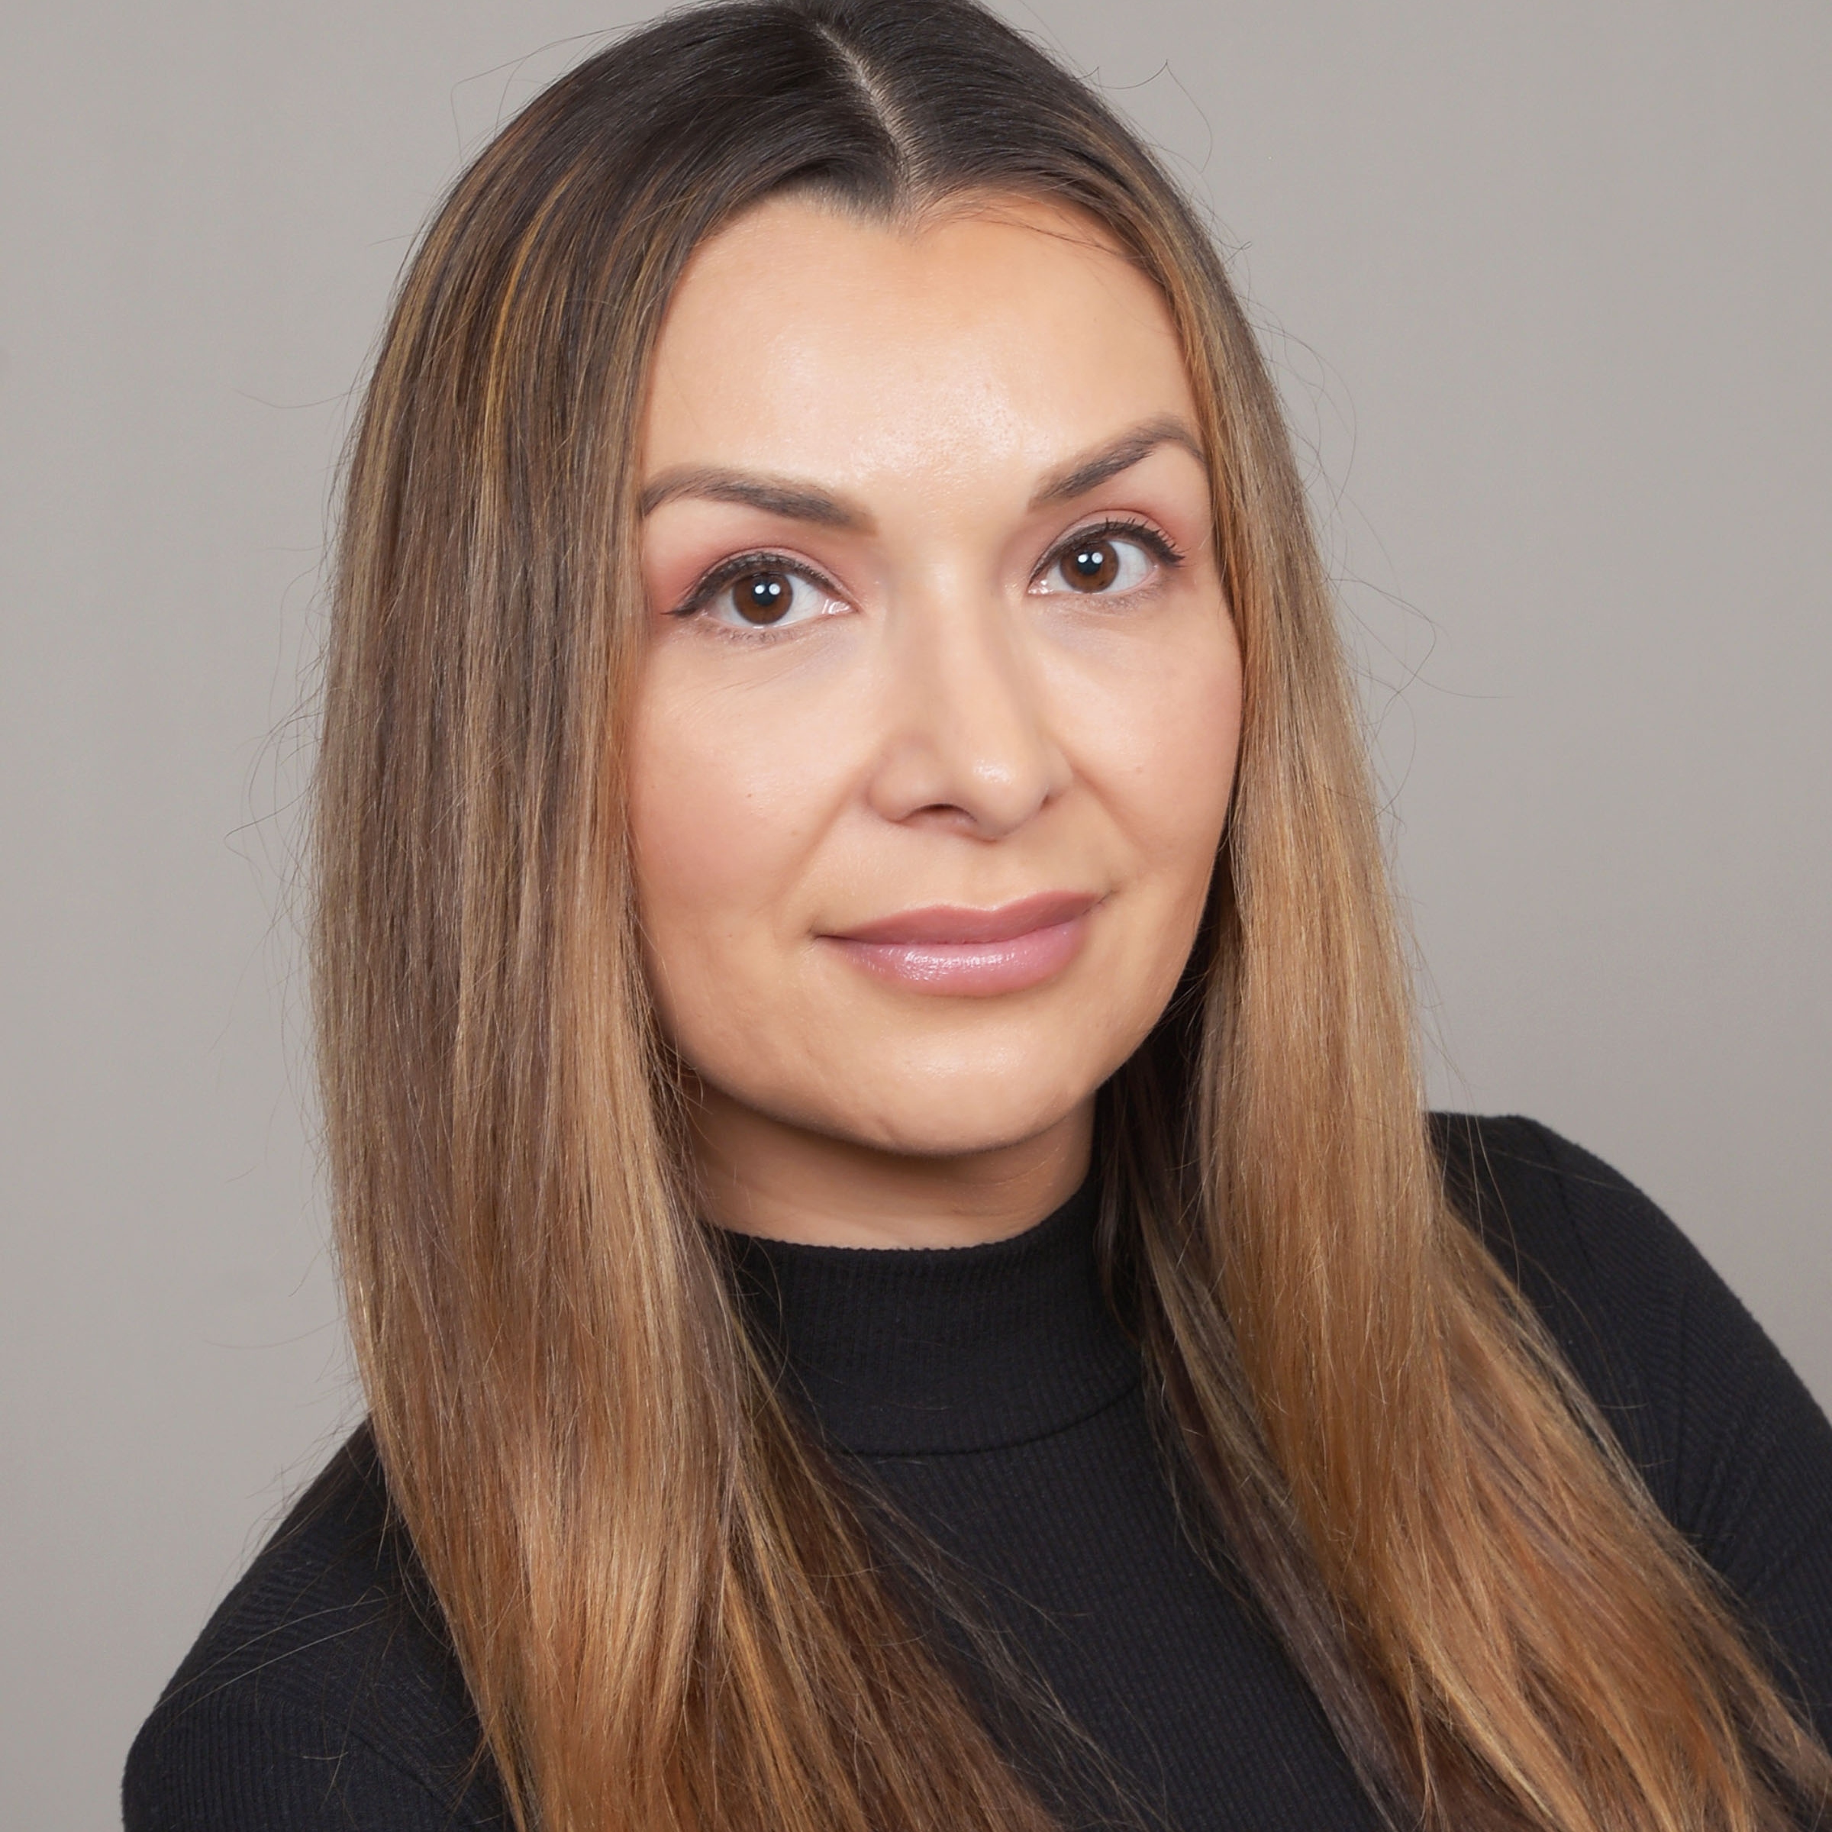
Nadia Knops Manager Experiences
Email
Nadia.knops@thebridge.com
Location
Dallas, Texas
Mobile
(972) 626-3048
With over a decade of experience in UX/UI and a bachelor's degree in visual communications, Nadia embarked on her career in graphic design before transitioning to web design. After discovering her passion for user experience design, she places high value on direct feedback from users, witnessing firsthand the significant impact of her work on individuals' lives.
Nadia has specialized in designing digital products within cross-functional teams. Her expertise now encompasses a comprehensive understanding of user experience, blending strategy, research, interaction, and visual design to create impactful solutions.
EXPERIENCE
Industry Experience
Healthcare, Technology, Retail, Local Government, Financial Services
Walmart
Improved the associate experience by adding features for requesting time-off on their mobile app, audited experiences and crafted prototypes to enhance the hiring process, utilizing artifacts like user flows and wireframes to drive innovation and efficiency.
CloudBees Inc
Spearheaded the redesign of the CD product, led workshops to establish a strategy, and created roadmaps. Contributed to the UI pattern library, coordinated usability tests, and pioneered the creation of the first sales journey map to document the onboarding experience.
projekt202
Worked with Dell Technologies on the redesign of their design system/language website. Designed the Feature Store for Amazon SageMaker Studio. Led the redesign of the 360° evaluation process internally for the design practice.
SKILLS
Capital One
Led research, strategy, and design to reimagine the report escalation process. Organized and facilitated multiple workshops to highlight friction points for analysts and their clients. Created a solution that enhances the report writing process and report quality.
Experience Design Strategy, User Research and Testing, Workshop Strategy and Facilitation, UX Design, UI Design, Graphic Design

